Slide 1

Search 1

Slide 2
Agent that searches
a world is a set of states
we first consider a world using atomic representation
atomic representation: state is the basic unit
states that can be factored will be considered later
the big O representation: e.g. O(n)

Slide 3
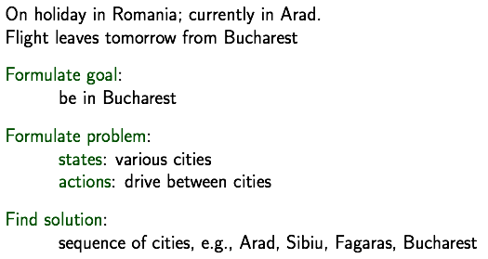
Example: Romania

Slide 4
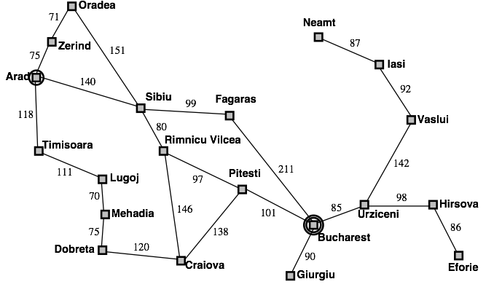
Example: Romania
map:

Slide 5
Problems
A problem is defined by 5 components:
initial state
possible actions (and state associated actions)
transition model
taking an action will cause a state change
goal test
judge if the goal state is found
path cost
constitute the cost of a solution

Slide 6

Problems
cost
state
initial state
transition
actions
goal

Slide 7
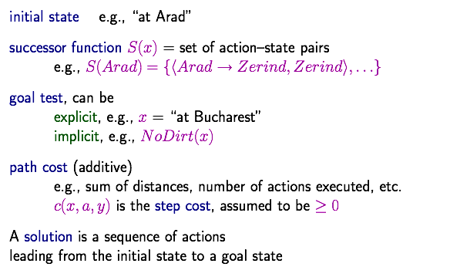
Problems
<-- transition

Slide 8
Problems
we assume
observable states (a seen state is accurate)
discrete states
deterministic transition
in partial observable case, states are not accurate 部分可见，如打牌
there are also continuous state spaces
there could be stochastic transitions

Slide 9
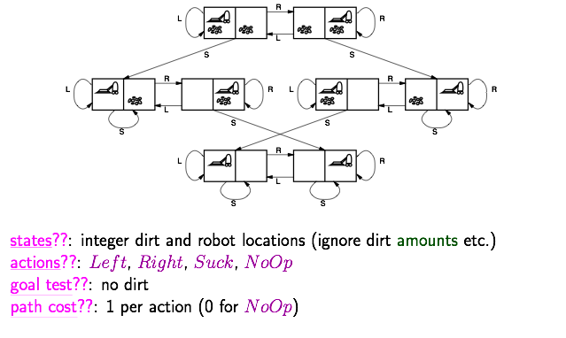
Example: vacuum world

Slide 10
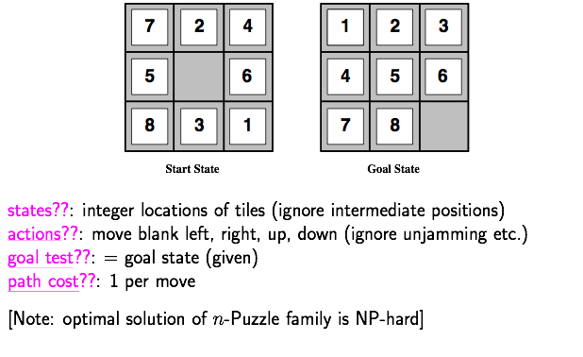
Example: 8-puzzle

Slide 11
Search Algorithms

Slide 12
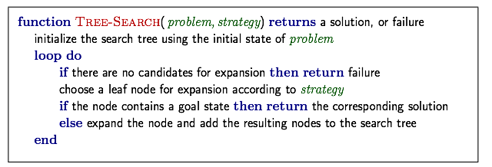
Tree search
1. start from the initial state
2. expand the current state
essence of search: following up one option now and putting the others aside
All search algorithms share this tree search structure
they vary primarily according to how they choose which state to expand --- the so-called search strategy

Slide 13
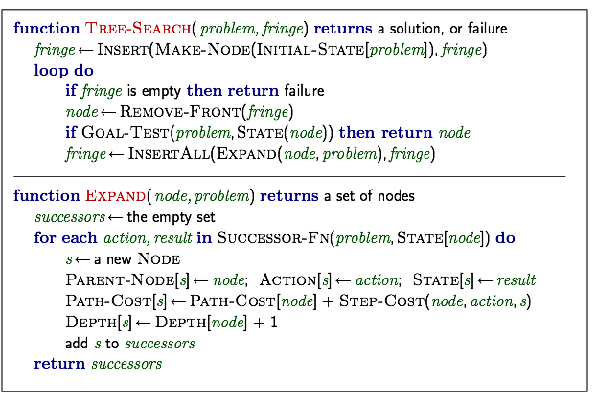
General tree search
note the time of goal-test: expanding time not generating time

Slide 14
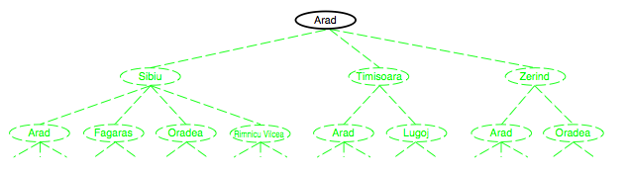
Example

Slide 15
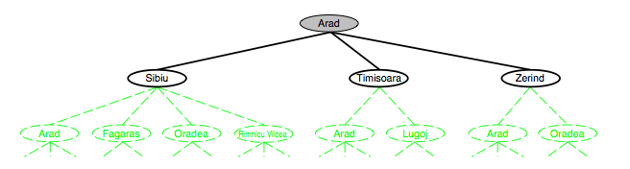
Example

Slide 16
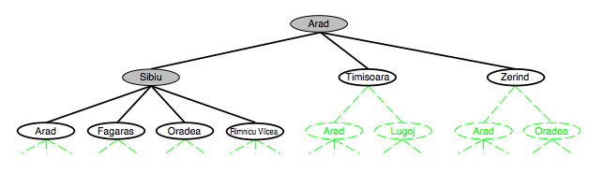
Example

Slide 17

Example

Slide 18
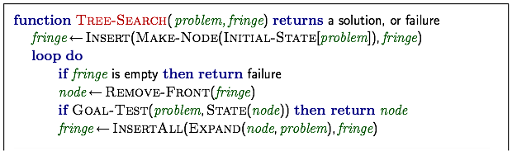
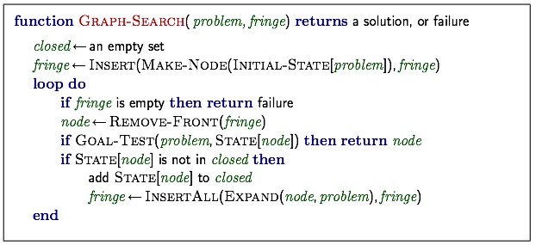
Graph search

Slide 19




Graph separation property
the fringe (expandable leaf nodes) separates the visited and the unexplored nodes
Homework: prove this property
Requirement:
Formally formulate this property
Give the formal proof
Writing report via Latex (template will be given)

Slide 20
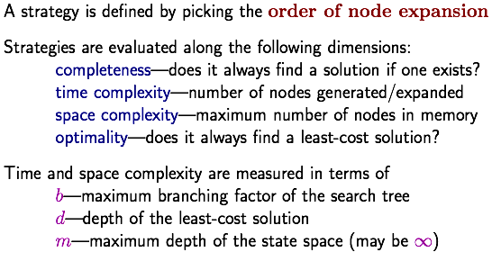
Search strategies

Slide 21
Different Environment Properties

Slide 22

Nondeterministic actions
almost all real-world problems are nondeterministic
how do you solve this problem?

Slide 23
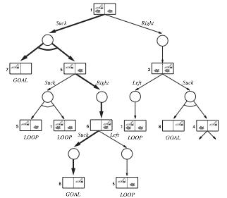
AND-OR tree search
OR node: different actions (as usual)
AND node: different transitions
a solution is not a path but a tree

Slide 24
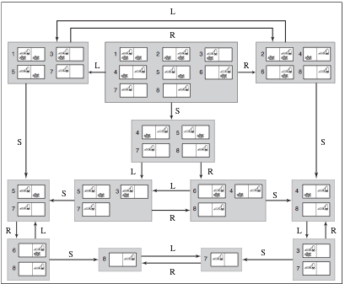
Search with no observations
search in belief (in agent’s mind)

Slide 25
Uninformed Search
Informed Search
Beyond Classical Search
Adversarial Search

Slide 26
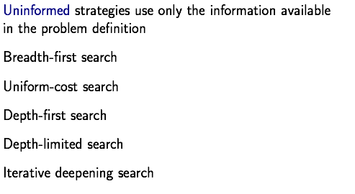
Uninformed Search Strategies

Slide 27
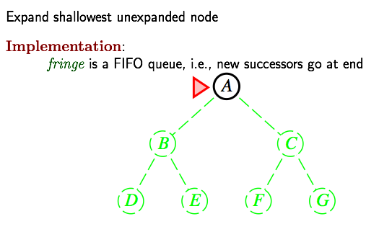
Breadth-first search

Slide 28
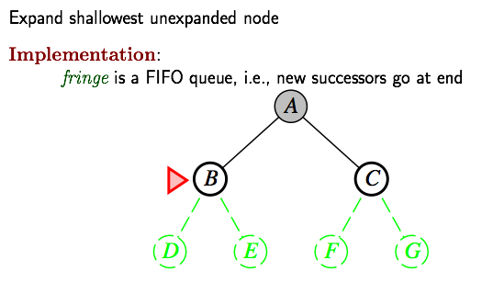
Breadth-first search

Slide 29
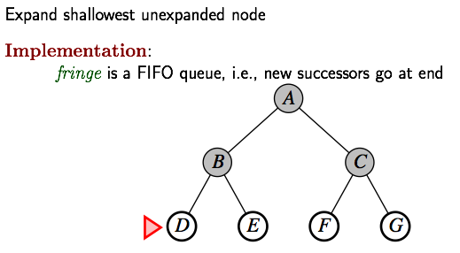
Breadth-first search

Slide 30
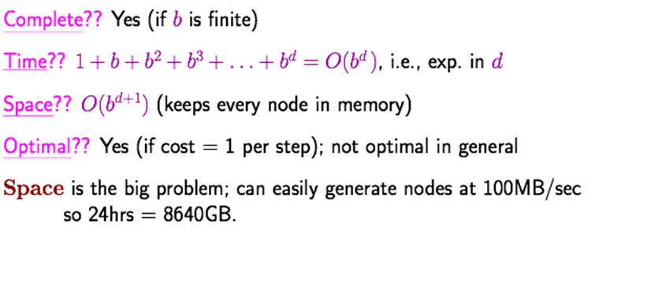
Properties

Slide 31
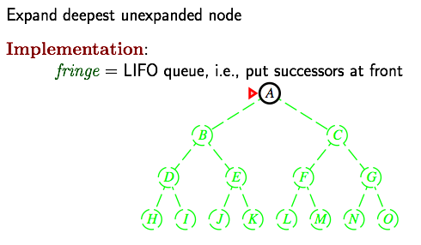
Depth-first search

Slide 32
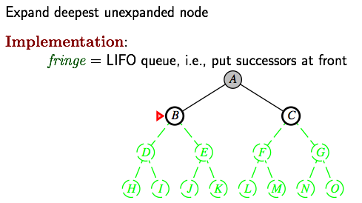
Depth-first search

Slide 33
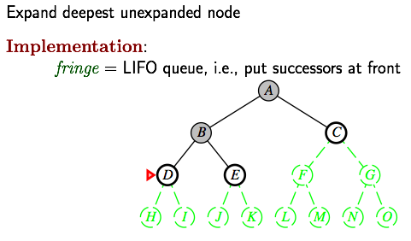
Depth-first search

Slide 34
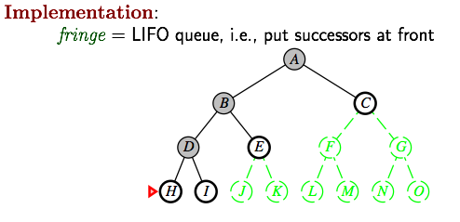
Depth-first search

Slide 35
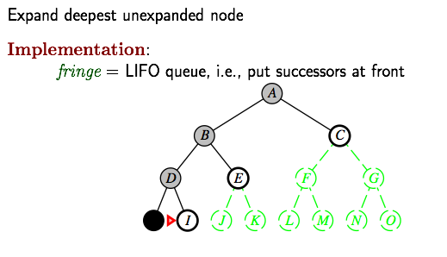
Depth-first search

Slide 36
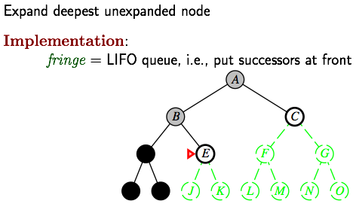
Depth-first search

Slide 37
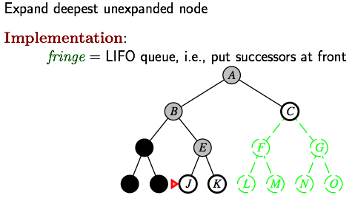
Depth-first search

Slide 38
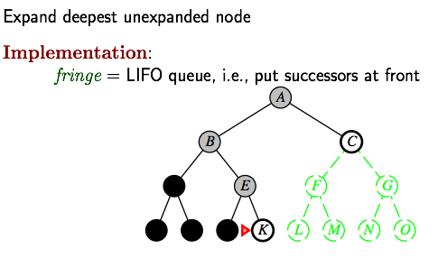
Depth-first search

Slide 39
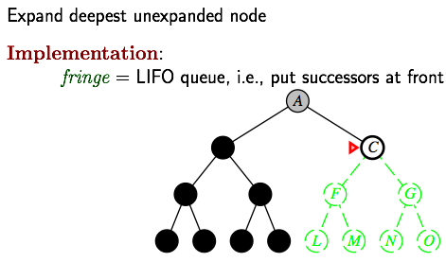
Depth-first search

Slide 40
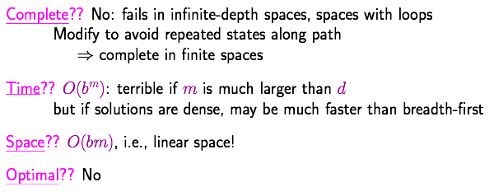
Properties
with repeated states avoid

Slide 41
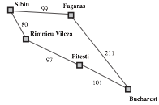
Uniform-cost search
Breadth-first search: First In First Out queue
Depth-first search: Last In First Out queue (stack)
Uniform-cost search: Priority queue (least cost out)
part of the map

Slide 42
Uniform-cost search
Breadth-first search: First In First Out queue
Depth-first search: Last In First Out queue (stack)
Uniform-cost search: Priority queue (least cost out)
part of the map
cost=99
cost=80

Slide 43
Uniform-cost search
Breadth-first search: First In First Out queue
Depth-first search: Last In First Out queue (stack)
Uniform-cost search: Priority queue (least cost out)
part of the map
cost=99
cost=80
cost=177

Slide 44
Uniform-cost search
Breadth-first search: First In First Out queue
Depth-first search: Last In First Out queue (stack)
Uniform-cost search: Priority queue (least cost out)
part of the map
cost=99
cost=80
cost=310
cost=177

Slide 45
Uniform-cost search
Breadth-first search: First In First Out queue
Depth-first search: Last In First Out queue (stack)
Uniform-cost search: Priority queue (least cost out)
part of the map
cost=99
cost=80
cost=310
cost=177
cost=278

Slide 46

Uniform-cost search
Breadth-first search: First In First Out queue
Depth-first search: Last In First Out queue (stack)
Uniform-cost search: Priority queue (least cost out)
Equivalent to breadth-first if step costs all equal
part of the map
cost=99
note the time of goal-test: expanding time not generating time
cost=80
cost=310
cost=177
cost=278
best path from Sibiu to Bucharest

Slide 47
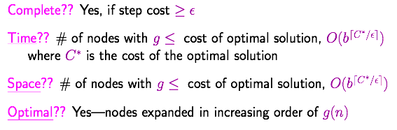

Properties
The cost of each action is $ε \text{at} \text{least}\text{.}$
Question: why it is optimal?
Homework: prove this property
Requirement:
Formally formulate this property
Give the formal proof
Writing report via Latex (template will be given)

Slide 48
Breadth-first v.s. depth-first
Breadth-first: faster, larger memory
Depth-first: less memory, slower
Question: how to better balance time and space?

Slide 49
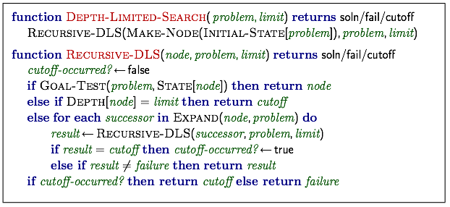
Depth-limited search
limit the maximum depth of the depth-first search
i.e., nodes at depth l have no successors
Cutoff指在深度界限内无解

Slide 50
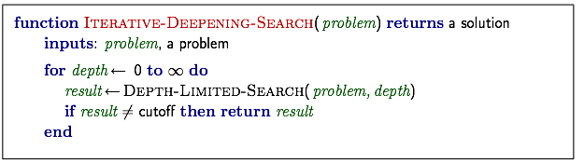
Iterative deepening search
try depth-limited search with increasing limit
restart the search at each time

Slide 51


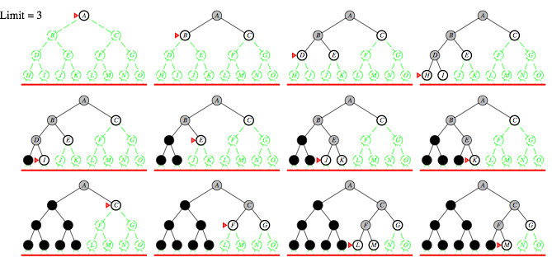
Example
wasteful searching the beginning nodes many times?

Slide 52
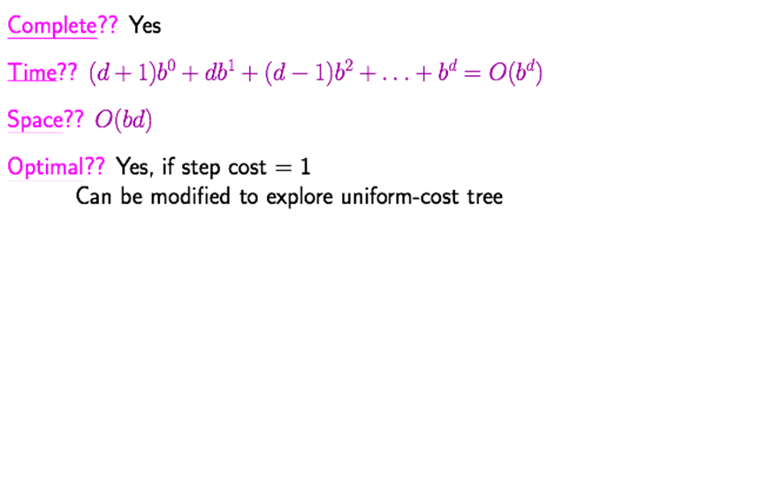

Properties
in the same order as the breadth-first search
small space as depth-first search

Slide 53
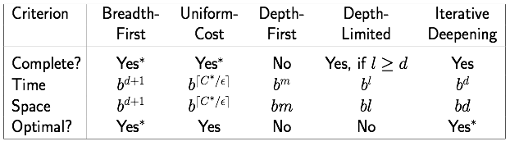
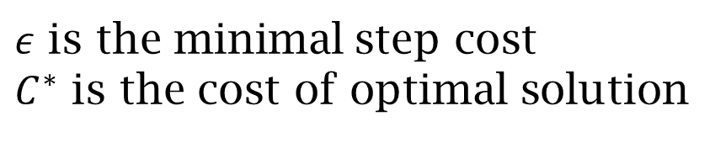
Summary
Optimal:* 单步代价相同
$ε$ is the minimal step cost
$C^{∗}$ is the cost of optimal solution

